Slide 1
Describing Distributions 2

Slide 2
Description
Location – mean and median
Spread – Range of scores gives information about their spread
Shape – symmetry, gaps, more/less dense regions, outliers, modality, convey information about the shape of a distribution
Anything else of relevance

Slide 3
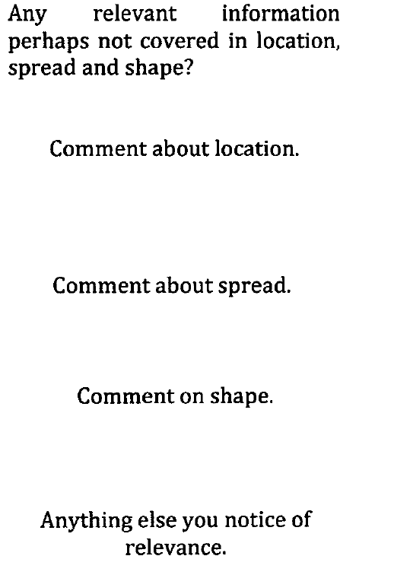
Introduction
Open with a short description of the data.
Body
This is the section where you show how you interpret the distributions.
Conclusion (sort of)
State anything which you think is relevant.

Slide 4
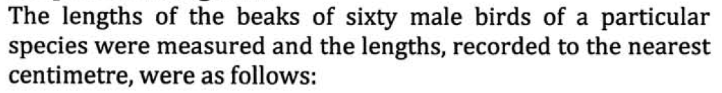
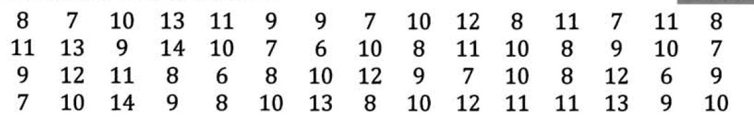
Histogram vs Boxplot

Slide 5
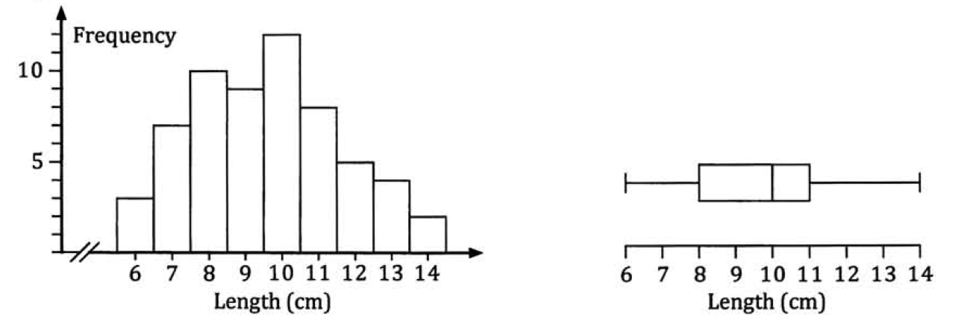
Histogram:
Convey the overall shape of the distribution
Symmetry, grouping, gaps, modes etc.
Can determine the mean and standard deviation.
Boxplot:
Five number summary: median, lowest and highest scores, lower quartile and upper quartile.
Range and interquartile range.
Can draw several boxplots to be drawn in close proximity.

Slide 6
Description
Location – Where is it?
Spread – How spread out is it?
Shape – What does it look like?
Anything else of relevance
Can now include Standard deviation.
Standard deviation is a number used to tell how measurements for a group are spread out from the mean.
A low standard deviation means that most of the numbers are very close to the mean.
A high standard deviation means that the numbers are spread out.

Slide 7
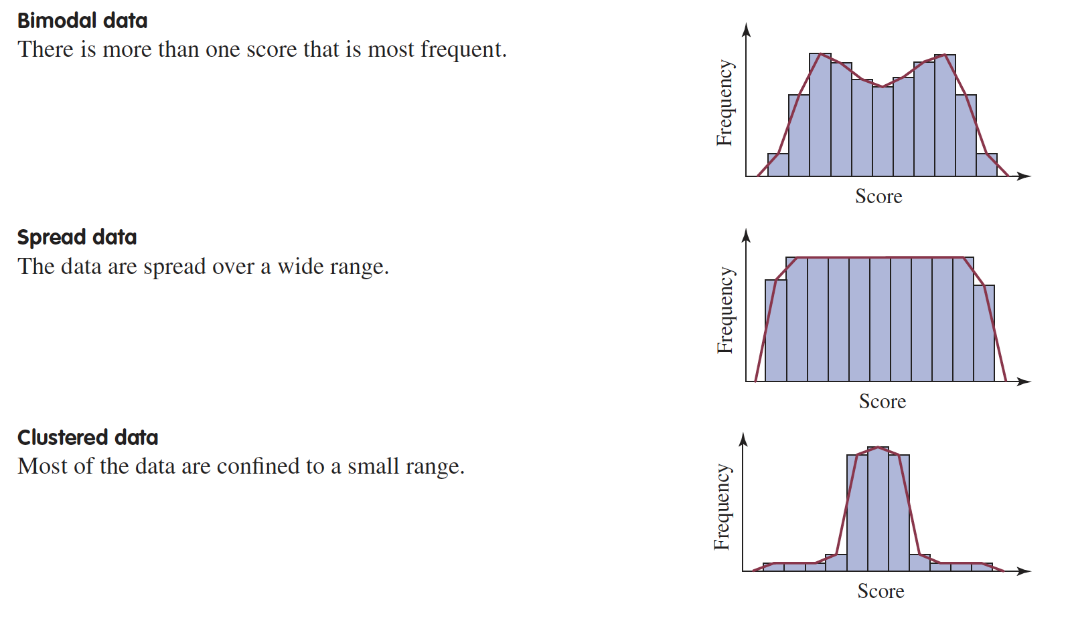

Slide 8
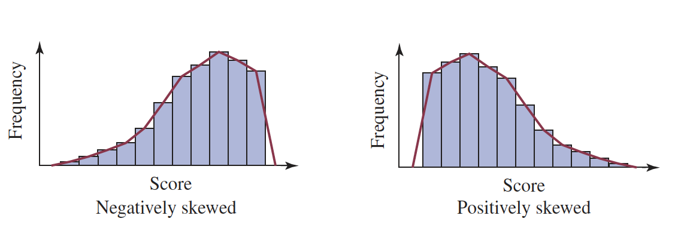
Skewness
Skew to the left
Skew to the right

Slide 9
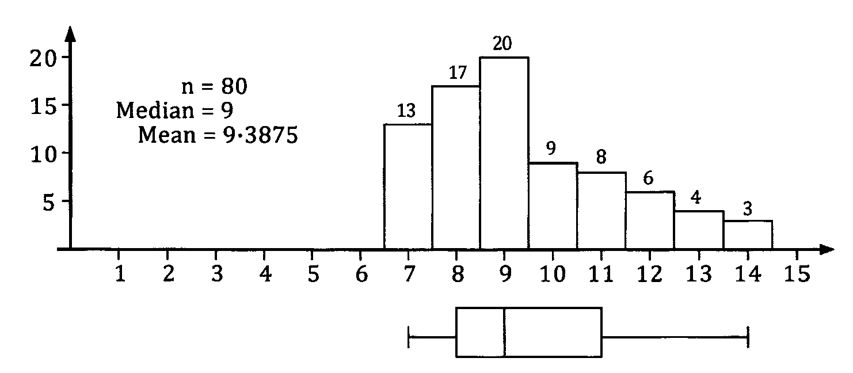
Positively skewed (skew to the right)
Longer ”tail” in the positive direction.
Mean > median
Boxplot will tend to be longer to the right of the median.

Slide 10
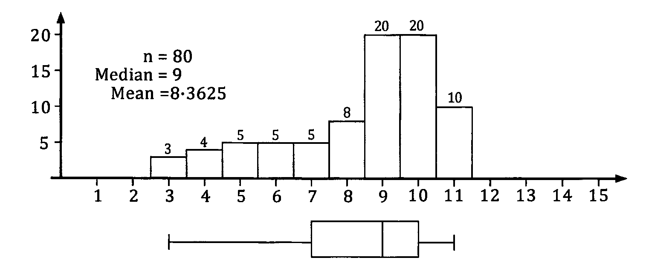
Negatively skewed (skew to the left)
Longer ”tail” in the negative direction.
Median < mean
Boxplot will tend to be longer to the left of the median.

Slide 11
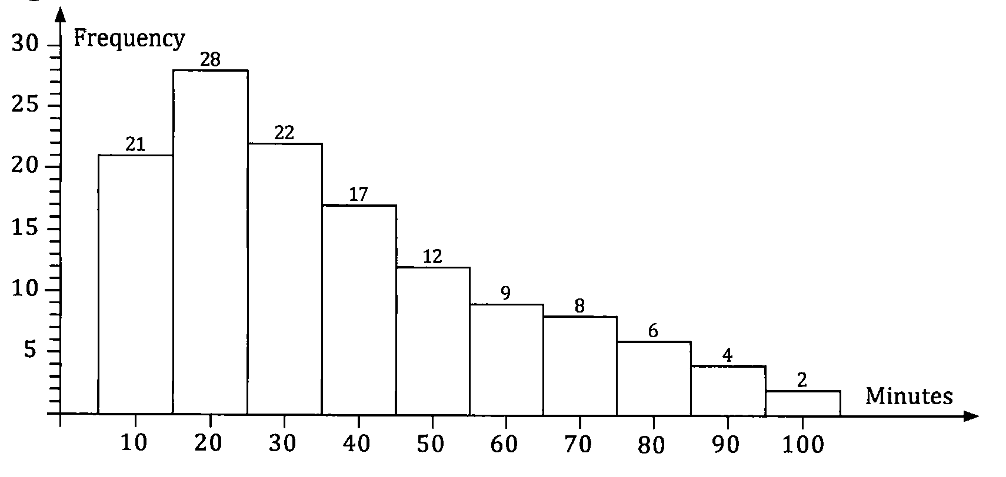

Slide 12
Introduction
Open with a short description of the data.
Body
This is the section where you show how you interpret the distributions.
Conclusion (sort of)
State anything which you think is relevant.

